Slide 1
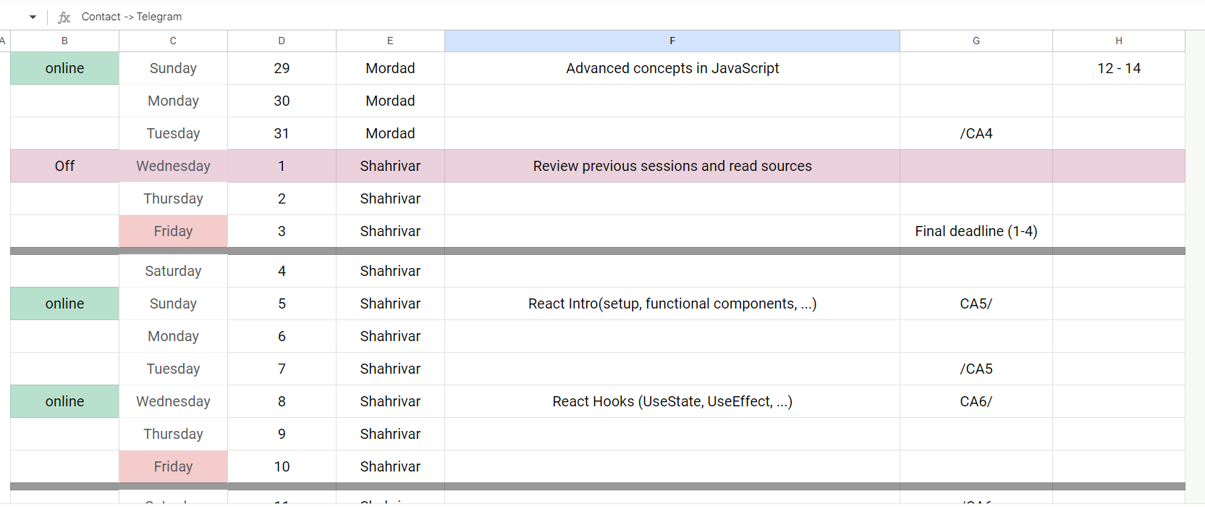
Calendar has been modified!

Slide 2

Advanced Concepts
JavaScript

Slide 3
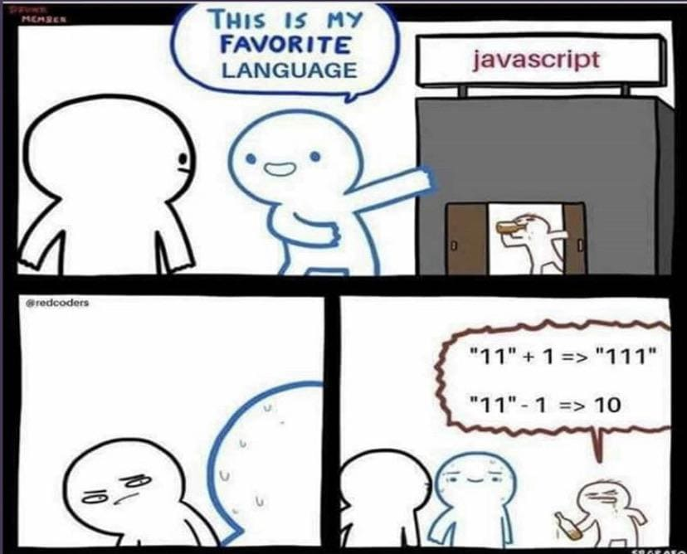

Slide 4
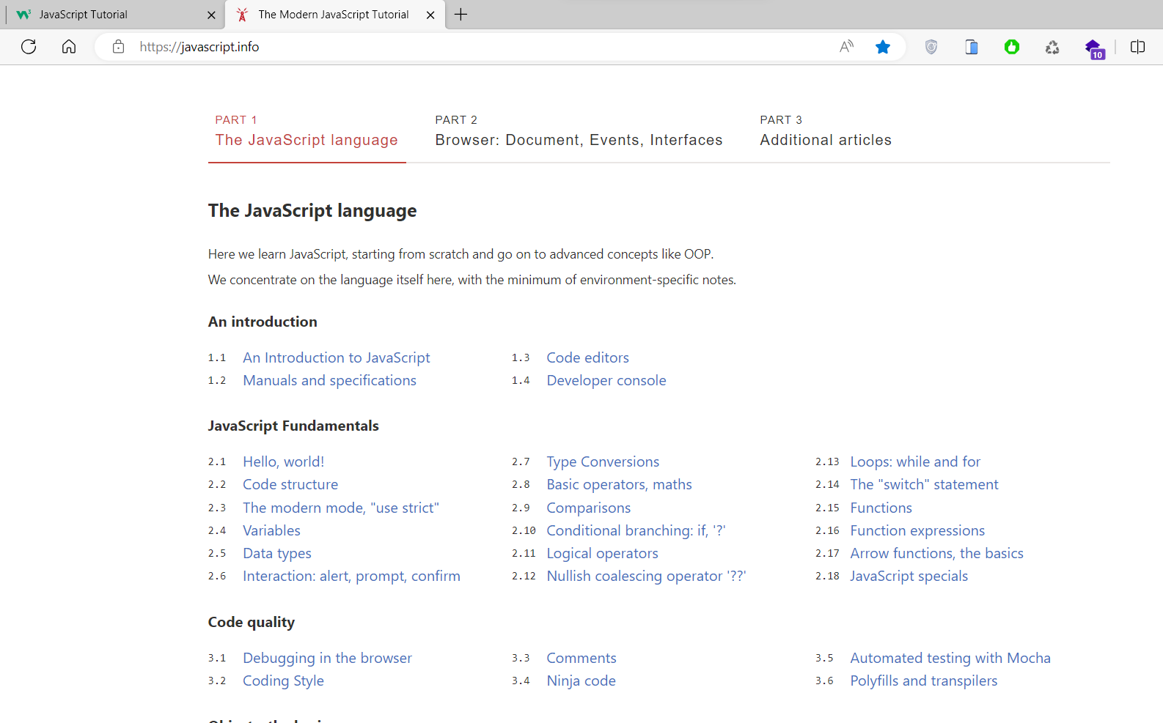

The Modern JavaScript Tutorial

Slide 5
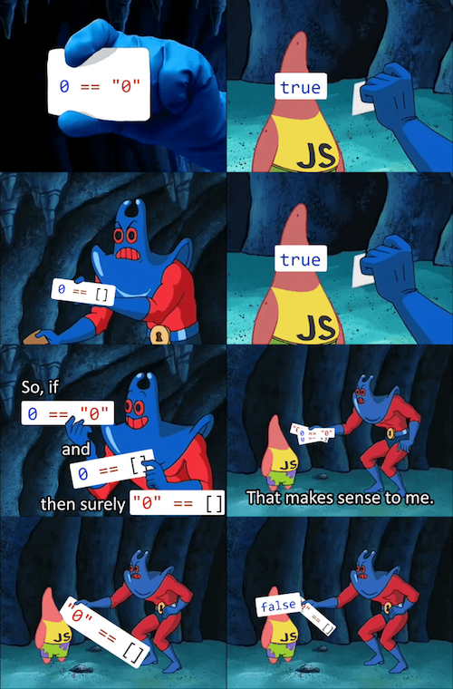

Slide 6
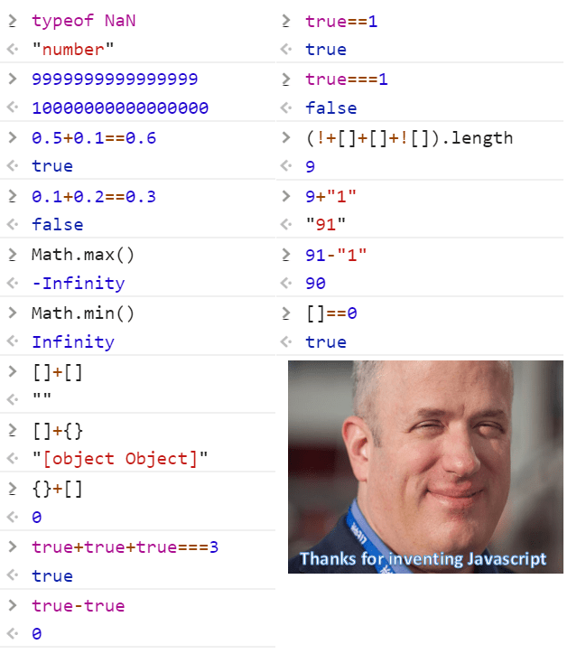

Slide 7
